Slide 1

Predictive Analytics for Business Strategy

Slide 2
By the end of this class, you should be able to:
Interpret and explain coefficients for:
Dummy variables
Categorical variables
Interaction terms
(Natural) logarithm

Slide 3
Categorical variables example

Slide 4
Practice with dummy variables
For this example, we’ll use Class 6.2 worksheet 4.
Just to keep it in two dimensions, we’ll ignore TaxHike for the moment.
This data has 3 different states:
Illinois
Indiana
Michigan

Slide 5
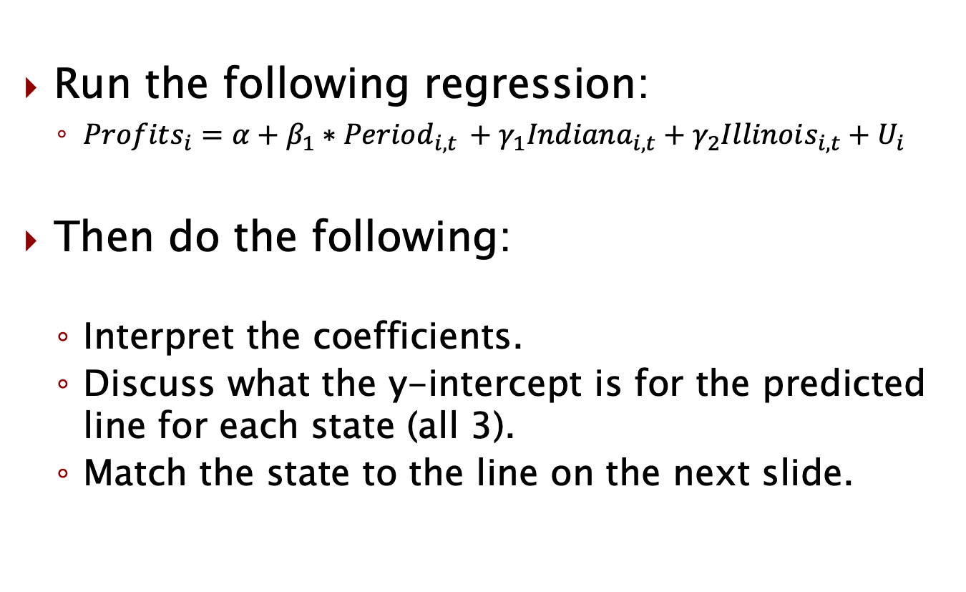
Practice with dummy variables
Run the following regression:
$Profits_{i}=α+β_{1}∗Period_{i,t }+γ_{1}Indiana_{i,t}+γ_{2}Illinois_{i,t}+U_{i}$
Then do the following:
Interpret the coefficients.
Discuss what the y-intercept is for the predicted line for each state (all 3).
Match the state to the line on the next slide.

Slide 6
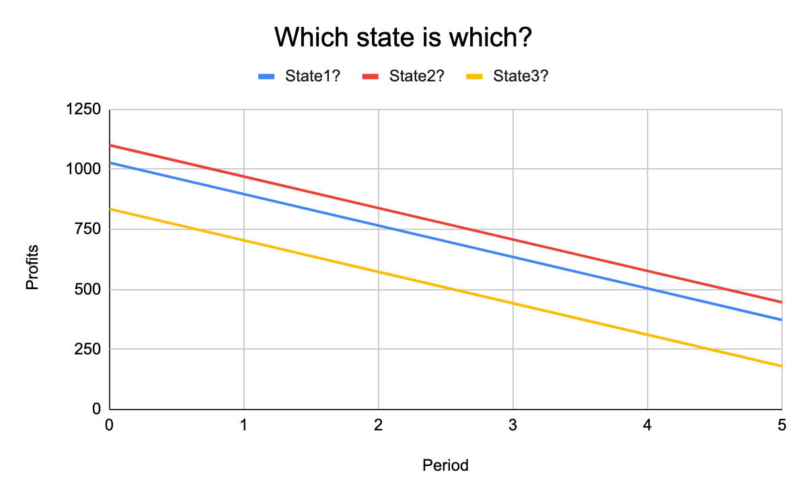

Slide 7
Categorical variables
Suppose instead of dummy variables on each state, we had a single categorical variable for which state it was.
Here we can run the following regression:
reg profits period i.state
Compare this with:
reg profits period Indiana Illinois

Slide 8
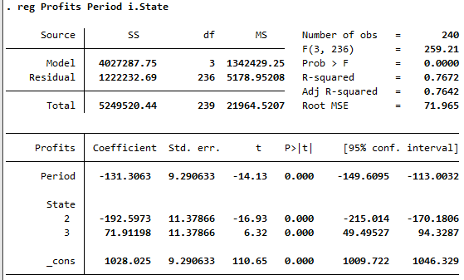
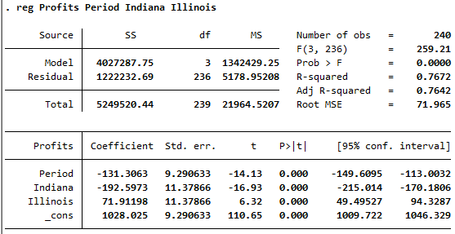
Categorical variables

Slide 9
Dummy variables and categorical variables

Slide 10
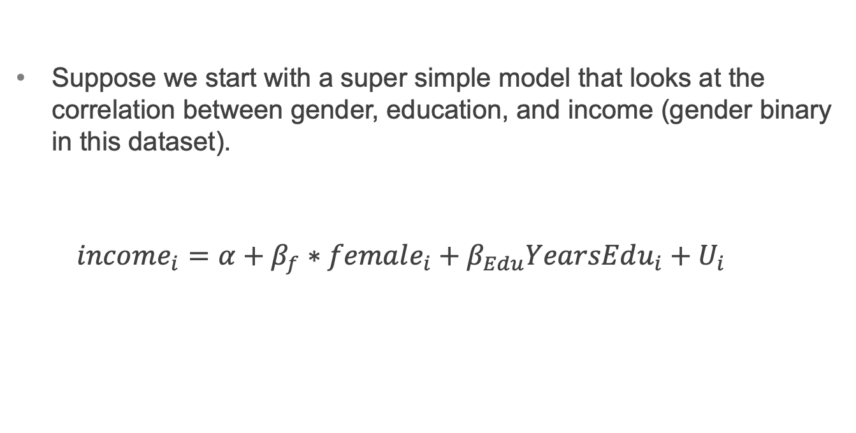
Education, gender, and income
Suppose we start with a super simple model that looks at the correlation between gender, education, and income (gender binary in this dataset).
$$income_{i}=α+β_{f}∗female_{i}+β_{Edu}YearsEdu_{i}+U_{i}$$

Slide 11
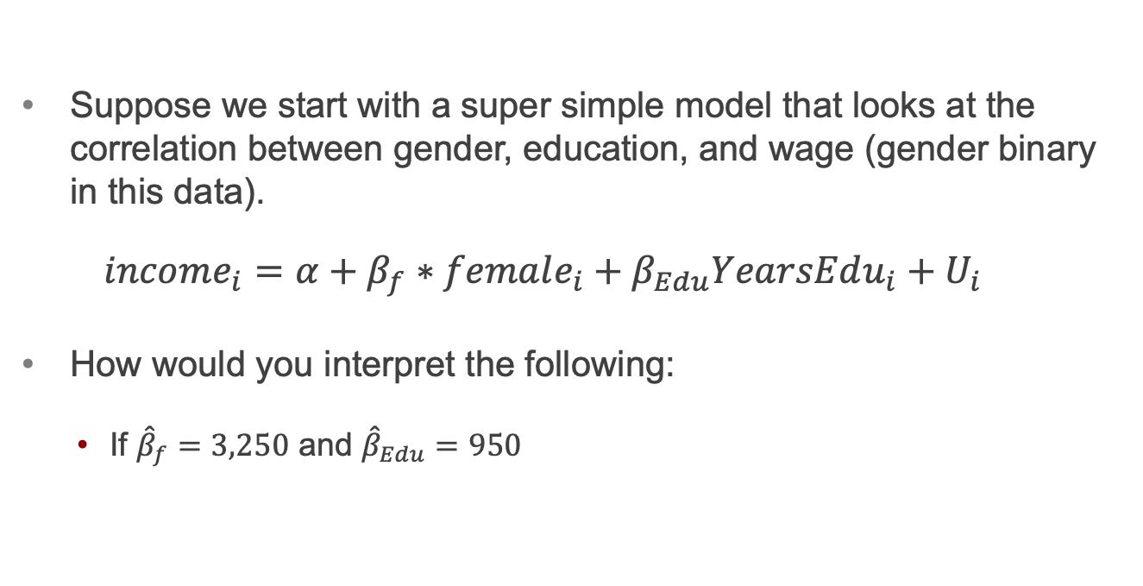
Education, gender and income
Suppose we start with a super simple model that looks at the correlation between gender, education, and wage (gender binary in this data).
$$income_{i}=α+β_{f}∗female_{i}+β_{Edu}YearsEdu_{i}+U_{i}$$
How would you interpret the following:
If ${\hat{β}}_{f}=3,250$ and ${\hat{β}}_{Edu}=950$

Slide 12
Education, gender and income
Suppose we change the model so that we don’t have years of education, but we have the following categories of education level:
High school or less (HS)
Some college (Some)
College graduate (Grad)
How would we include these in the model?

Slide 13
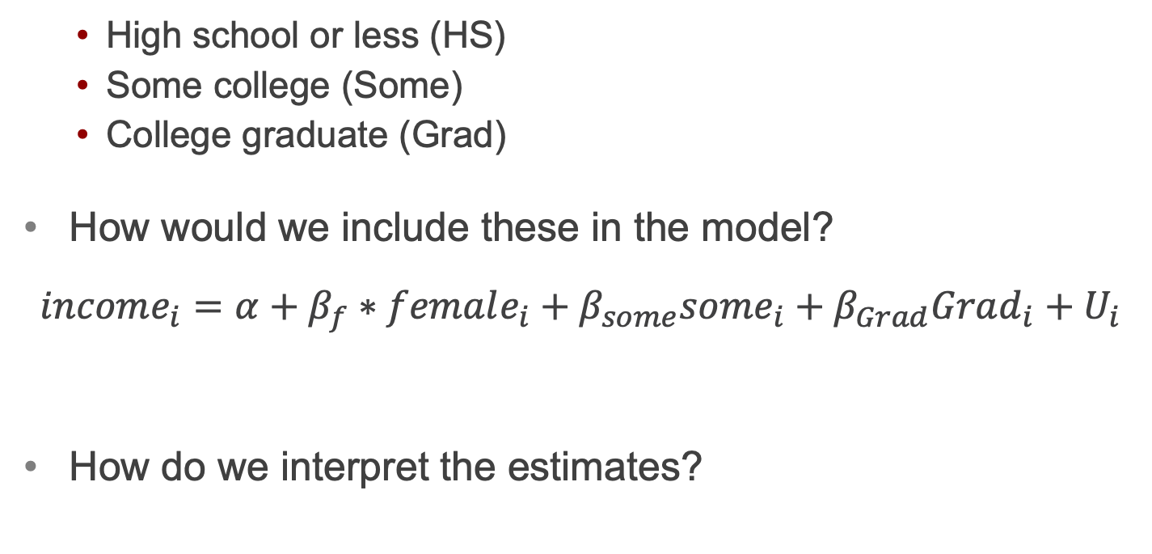
*Education, gender and income
High school or less (HS)
Some college (Some)
College graduate (Grad)
How would we include these in the model?
$$income_{i}=α+β_{f}∗female_{i}+β_{some}some_{i}+β_{Grad}Grad_{i}+U_{i}$$
How do we interpret the estimates?

Slide 14
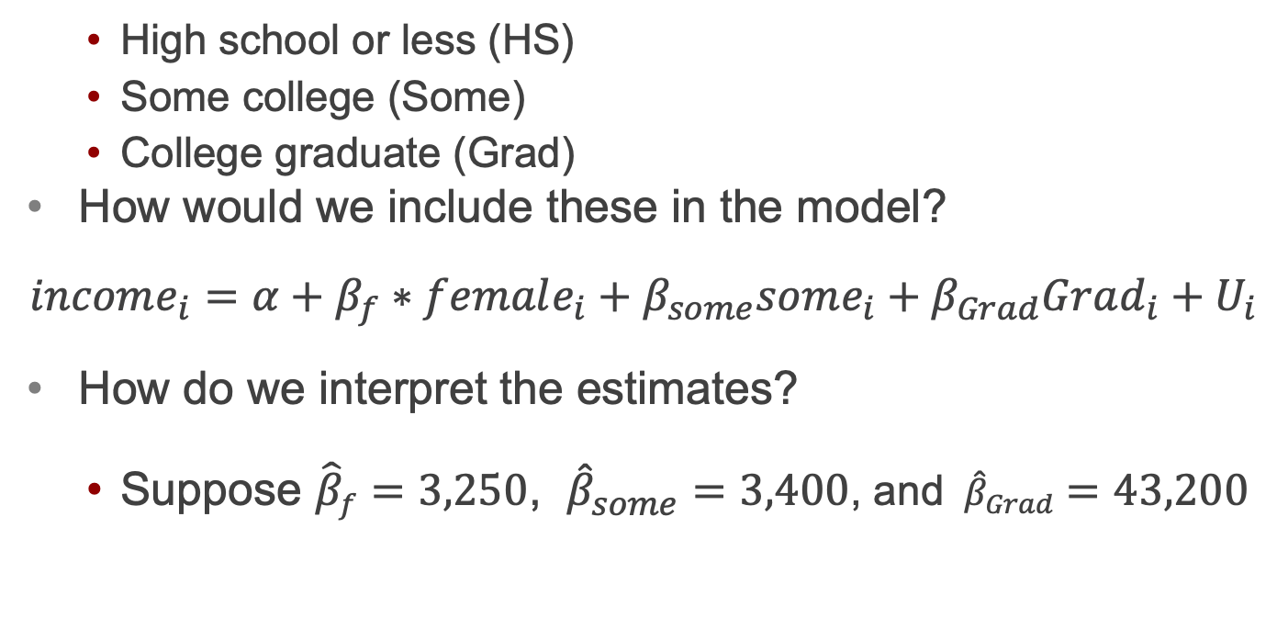
Education, gender and income
High school or less (HS)
Some college (Some)
College graduate (Grad)
How would we include these in the model?
$$income_{i}=α+β_{f}∗female_{i}+β_{some}some_{i}+β_{Grad}Grad_{i}+U_{i}$$
How do we interpret the estimates?
Suppose ${\hat{β}}_{f}=3,250$, ${\hat{β}}_{some}=3,400$, and ${\hat{β}}_{Grad}=43,200$

Slide 15
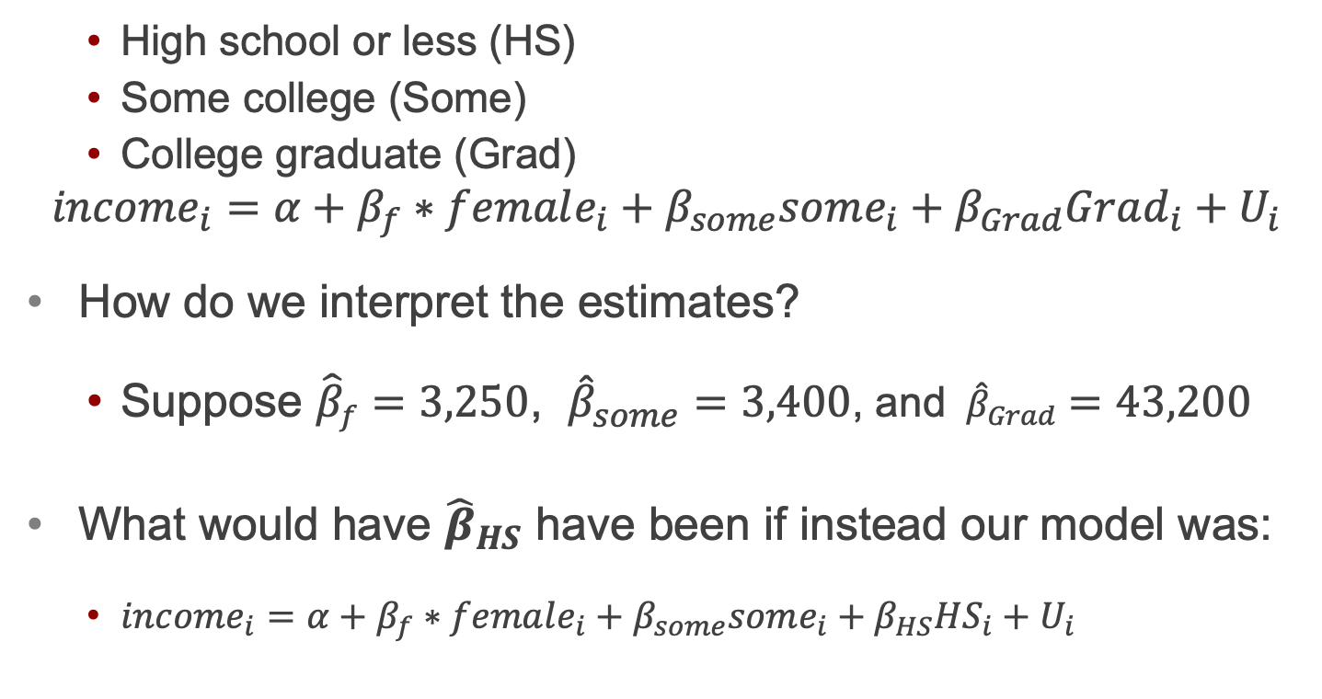
Education, gender and income
High school or less (HS)
Some college (Some)
College graduate (Grad)
$$income_{i}=α+β_{f}∗female_{i}+β_{some}some_{i}+β_{Grad}Grad_{i}+U_{i}$$
How do we interpret the estimates?
Suppose ${\hat{β}}_{f}=3,250$, ${\hat{β}}_{some}=3,400$, and ${\hat{β}}_{Grad}=43,200$
What would have ${\hat{β}}_{HS}$ have been if instead our model was:
$income_{i}=α+β_{f}∗female_{i}+β_{some}some_{i}+β_{HS}HS_{i}+U_{i}$

Slide 16
Another example
Suppose we we had nightly sales data for a restaurant.
We also have information on whether or not they have a promotion going that night.
Let’s explore what the relationship might be between sales and days of the week as well as promo.
Could you make what day it is into a binary variable?

Slide 17
Day of the week column
If you look at the second worksheet, you’ll notice instead of dummy variables, day of the week is a categorical variable.
Here is how you can run that regression (without creating a bunch of dummy variables through coding):
reg Revenue i.Day Promo

Slide 18
Interaction terms

Slide 19
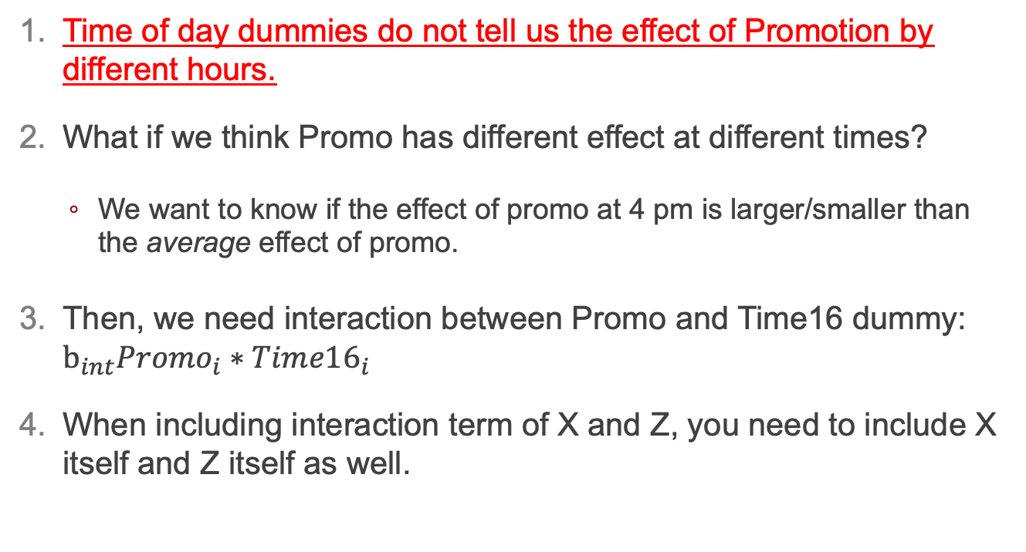
The effect of Promotion by hours?
Time of day dummies do not tell us the effect of Promotion by different hours.
What if we think Promo has different effect at different times?
We want to know if the effect of promo at 4 pm is larger/smaller than the average effect of promo.
Then, we need interaction between Promo and Time16 dummy: $b_{int}Promo_{i}∗Tim{e16}_{i}$
When including interaction term of X and Z, you need to include X itself and Z itself as well.
$$Sales_{i}=b_{0}+b_{1}Promo_{i}+b_{16}Tim{e16}_{i}+b_{int}Promo_{i}∗Tim{e16}_{i}+U_{i}$$

Slide 20

Interpreting interaction terms $b_{int}$ (assuming causal)
$$Sales_{i}=b_{0}+b_{1}Promo_{i}+b_{16}Tim{e16}_{i}+b_{int}Promo_{i}∗Tim{e16}_{i}+U_{i}$$
Predicted sales when no promo is given at non-4 pm =
Predicted sales when promo is given at non-4 pm =
=> the effect of promo on sales at non-4 pm is
Predicted sales when no promo is given at 4 pm =
Predicted sales when promo is given at 4 pm =
=> the effect of promo on sales at 4 pm is
=> the effect of promo on sales at 4 pm is higher than the effect of promo on sales at non-4 pm.

Slide 21
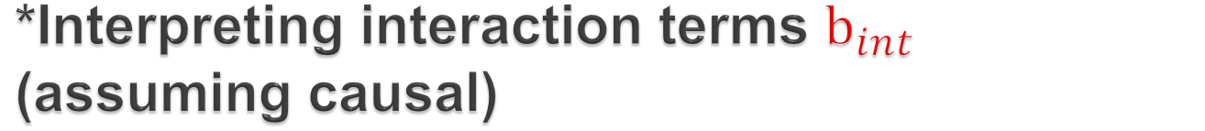
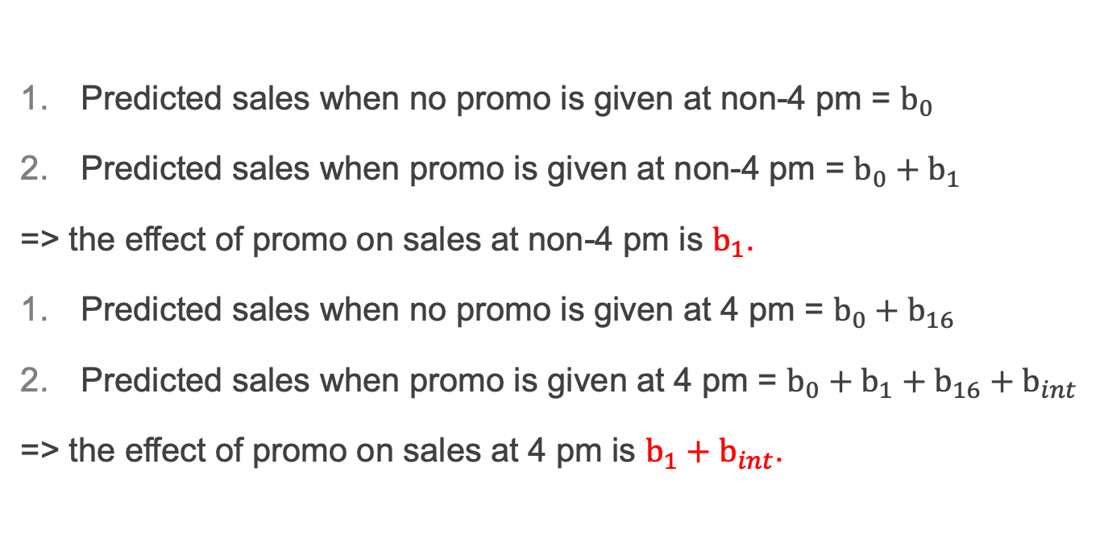
*Interpreting interaction terms $b_{int}$ (assuming causal)
$$Sales_{i}=b_{0}+b_{1}Promo_{i}+b_{16}Tim{e16}_{i}+b_{int}Promo_{i}∗Tim{e16}_{i}+U_{i}$$
Predicted sales when no promo is given at non-4 pm = $b_{0}$
Predicted sales when promo is given at non-4 pm = $b_{0}+b_{1}$
=> the effect of promo on sales at non-4 pm is $b_{1}$.
Predicted sales when no promo is given at 4 pm = $b_{0}+b_{16}$
Predicted sales when promo is given at 4 pm = $b_{0}+b_{1}+b_{16}+b_{int}$
=> the effect of promo on sales at 4 pm is $b_{1}+b_{int}$.
=> the effect of promo on sales at 4 pm is $b_{int}$ higher than the effect of promo on sales at non-4 pm.

Slide 22
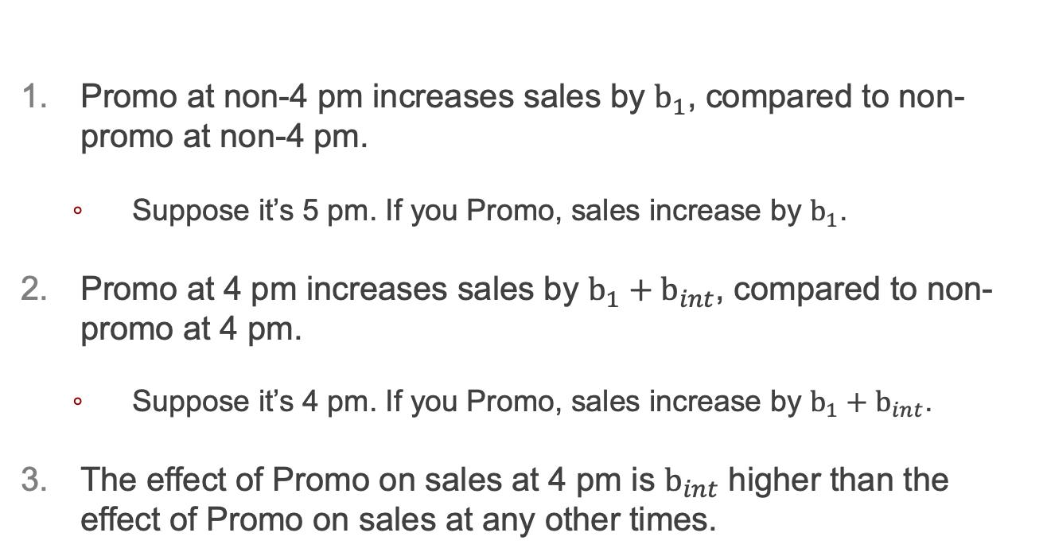
Repeating the previous slide
Promo at non-4 pm increases sales by $b_{1}$, compared to non-promo at non-4 pm.
Suppose it’s 5 pm. If you Promo, sales increase by $b_{1}$.
Promo at 4 pm increases sales by $b_{1}+b_{int}$, compared to non-promo at 4 pm.
Suppose it’s 4 pm. If you Promo, sales increase by $b_{1}+b_{int}$.
The effect of Promo on sales at 4 pm is $b_{int}$ higher than the effect of Promo on sales at any other times.
$$Sales_{i}=b_{0}+b_{1}Promo_{i}+b_{16}Tim{e16}_{i}+b_{int}Promo_{i}∗Tim{e16}_{i}+U_{i}$$

Slide 23
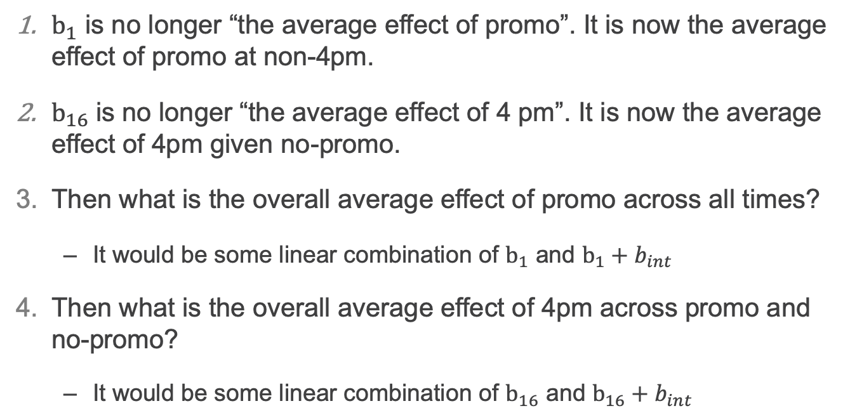
CAVEAT: When interaction is added
$$Sales_{i}=b_{0}+b_{1}Promo_{i}+b_{16}Tim{e16}_{i}+b_{int}Promo_{i}∗Tim{e16}_{i}+U_{i}$$
$b_{1}$ is no longer “the average effect of promo”. It is now the average effect of promo at non-4pm.
$b_{16}$ is no longer “the average effect of 4 pm”. It is now the average effect of 4pm given no-promo.
Then what is the overall average effect of promo across all times?
It would be some linear combination of $b_{1}$ and $b_{1}+b_{int}$
Then what is the overall average effect of 4pm across promo and no-promo?
It would be some linear combination of $b_{16}$ and $b_{16}+b_{int}$

Slide 24
Model with interaction term
Is Promo more effective during weekdays compared to weekend?
How would you answer this question? Let’s set up a regression model.
Which coefficient tells us the answer?

Slide 25
Model with interaction term
Include interaction between Promo and Weekend in the reg.
We must include each of these 3:
Promo dummy
Weekend dummy
Promo * Weekend
Interpret each coefficient. For simplicity, let’s assume we can do interpret them causally. Interpret them even if they are insignificant for the practice.

Slide 26
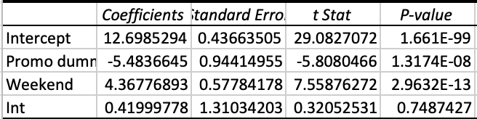
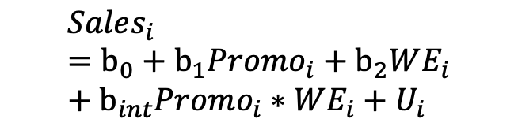
*Interaction of two dummies results
$$Sales_{i}=b_{0}+b_{1}Promo_{i}+b_{2}WE_{i}+b_{int}Promo_{i}∗WE_{i}+U_{i}$$
Promo dummy
On average, promotion lowers sales by $5.48 compared to no-promo during weekdays. ($5.06 for weekend)
Weekend dummy
On average, weekend increases sales by $4.37 compared to weekdays given no-promo. ($4.79 given promo)
Interaction (although it’s insignificant)
On average, the effect of promo on sales during weekend is $0.42 higher than the effect of promo on sales during weekdays.

Slide 27
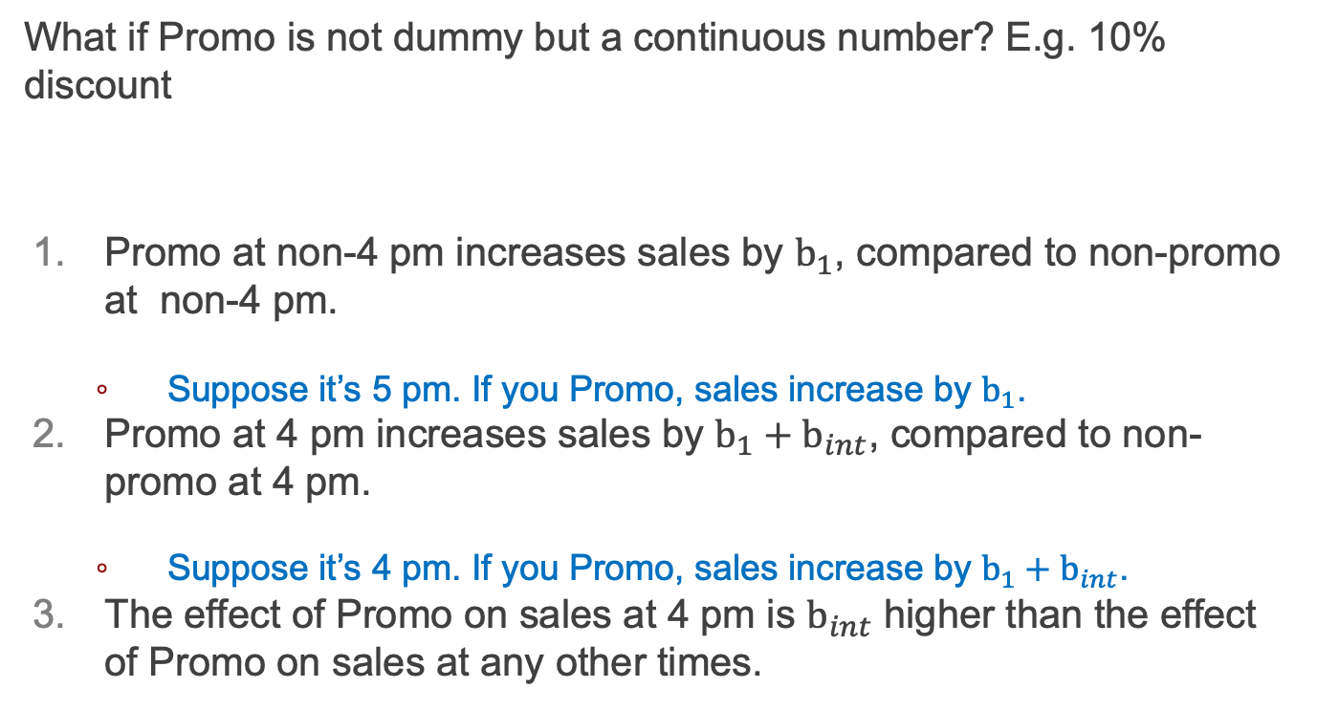
Interpreting interaction terms (assuming causal relationship established)
What if Promo is not dummy but a continuous number? E.g. 10% discount
Promo at non-4 pm increases sales by $b_{1}$, compared to non-promo at non-4 pm.
Suppose it’s 5 pm. If you Promo, sales increase by $b_{1}$.
Promo at 4 pm increases sales by $b_{1}+b_{int}$, compared to non-promo at 4 pm.
Suppose it’s 4 pm. If you Promo, sales increase by $b_{1}+b_{int}$.
The effect of Promo on sales at 4 pm is $b_{int}$ higher than the effect of Promo on sales at any other times.
1 unit increase in Promo

Slide 28
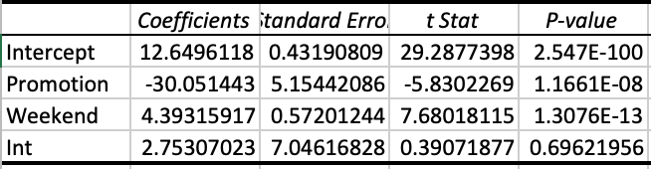
(Ex. 2) Interaction of a continuous variable and a dummy results
Promo (continuous)
On average, 1 unit increase in promotion decreases sales by $30.05 during weekdays ($27.3 for weekends).
Weekend dummy
On average, weekend increases sales by $4.39 compared to weekdays given promo = 0 ($4.39 + $2.75*promo for promo > 1).
Interaction (although it’s insignificant)
On average, the effect of promo on sales during weekend is $2.75 higher than the effect of promo on sales during weekdays.

Slide 29
Interpreting (natural) Log in Regressions

Slide 30
Percentage changes
There are lots of times where we might not think X and Y have a linear relationship, but it is possible that the % change in X is linearly related to the % change in Y.
And/or we are interested in percentage changes in either/both.

Slide 31
Elasticity of demand
You may have heard of (price) elasticity of demand before.
Do you remember what it is?

Slide 32
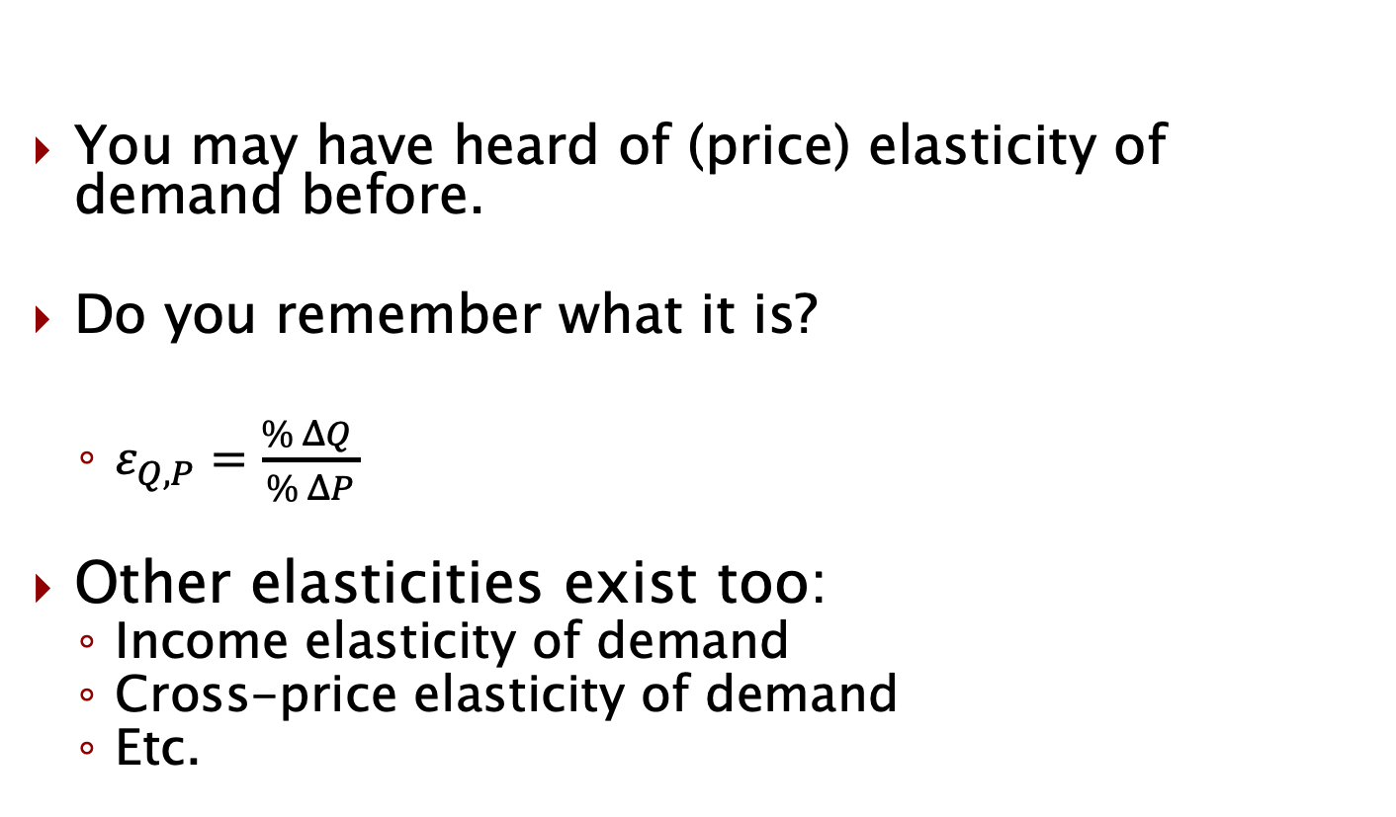
Elasticity of demand
You may have heard of (price) elasticity of demand before.
Do you remember what it is?
$ε_{Q,P}=\frac{\% ΔQ }{\% ΔP}$
Other elasticities exist too:
Income elasticity of demand
Cross-price elasticity of demand
Etc.

Slide 33
Interpreting log coefficients
For the log functional form, note that the standard meaning of “log” in econometrics is actually natural log.
For example, log(8) = the exponent on “e” (2.71828) that produces 8, so actually LN(8)
Why is (natural) log a popular choice?
It has a clear interpretation with respect to percentages
Sometimes we are directly interested in percentage effects
We also often want to know elasticities, which are in percentage terms

Slide 34
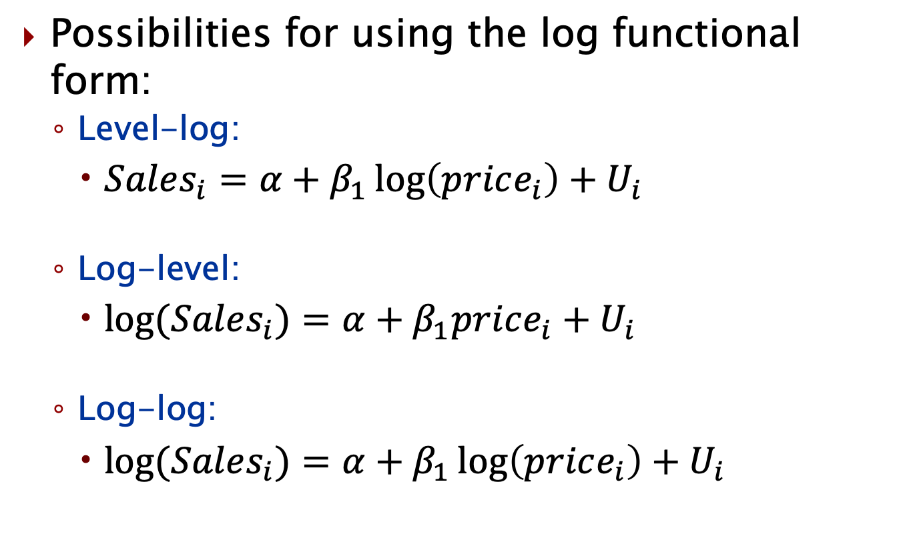
Interpreting log coefficients
Possibilities for using the log functional form:
Level-log:
$Sales_{i}=α+β_{1}\log\left(price_{i}\right)+U_{i}$
Log-level:
$log⁡(Sales_{i})=α+β_{1}price_{i}+U_{i}$
Log-log:
$log⁡(Sales_{i})=α+β_{1}\log\left(price_{i}\right)+U_{i}$

Slide 35
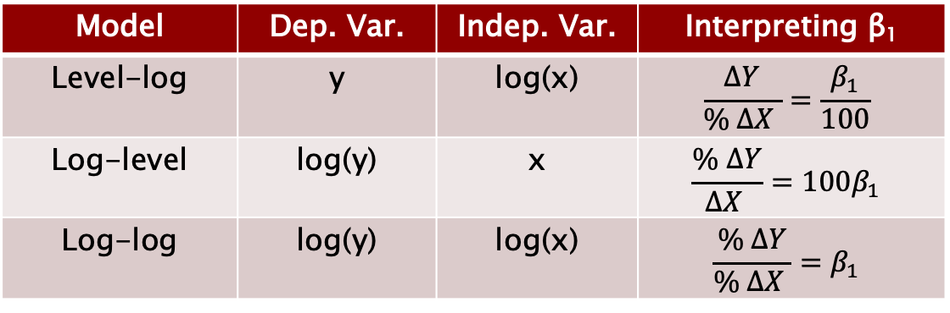
Interpreting log coefficients
Interpreting log functional forms:
Consider a simple Sales/Price model
Level-log, β₁ = -200
Log-level, β₁ = -0.04
Log-log, β₁ = -2
Model | Dep. Var. | Indep. Var. | Interpreting β₁
Level-log | y | log(x) | $$\frac{ΔY}{\% ΔX }=\frac{β_{1}}{100}$$
Log-level | log(y) | x | $$\frac{\% ΔY}{ΔX }=100β_{1}$$
Log-log | log(y) | log(x) | $$\frac{\% ΔY}{\% ΔX }=β_{1}$$

Slide 36
Interpreting log coefficients
Interpreting log functional forms:
Consider a simple Sales/Price model
Level-log, β₁ = -200
A 1% increase in Price will result in a decrease in sales of 2
Log-level, β₁ = -0.04
A $1 increase in Price will result in a 4% drop in Sales
Log-log, β₁ = -2
A 1% increase in Price will result in a 2% decrease in Sales
Model | Dep. Var. | Indep. Var. | Interpreting β₁
Level-log | y | log(x) | $$\frac{ΔY}{\% ΔX }=\frac{β_{1}}{100}$$
Log-level | log(y) | x | $$\frac{\% ΔY}{ΔX }=100β_{1}$$
Log-log | log(y) | log(x) | $$\frac{\% ΔY}{\% ΔX }=β_{1}$$

Slide 37
Elasticity of demand
Is elasticity of demand something we would estimate using a model for:
A. Active prediction
B. Passive prediction
C. Either
D. Neither
And of course….. Why?

Slide 38
Wrapping up
Today we learned how to interpret regressions with:
Dummy variables
Categorical variables
Interaction terms
(Natural) log

Slide 39
Announcements/reminders
Problem Set 3 due Sunday
Next week:
Class on Monday
Final exam on Wednesday on your own during class time
You have 80 minutes (out of 90 minute window) to take exam
20 questions on Canvas
18 multiple choice questions
2 short answer (similar to “why?/explain” questions from homework)

